Slide 1
POC for using MES models in clinical trials matching

Slide 2
Clinical Trial #1 – NCT01649297
A 16 Weeks Study on Efficacy and Safety of Two Doses of Empagliflozin (BI 10773) (Once Daily Versus Twice Daily) in Patients With Type 2 Diabetes Mellitus and Preexisting Metformin Therapy
983 participants , 139 locations.
Primary outcome: HbA1c Change From Baseline at Week 16
Completed

Slide 3
NCT01649297: Eligibility
Inclusion criteria:
confirmed diagnosis of T2DM
Glycated hemoglobin (HbA1c) >=7.0 and <=10/0% at Visit 1
Metformin therapy (at least 1500 mg/day, BID)
age>=18 at Visit 1
body mass index <=45 kg/m2
Exclusion criteria:
estimated creatinine clearance rate (eCCr) <60 ml/min (Cockcroft-Gault formula) screening and/or run-in
a confirmed glucose level >240 mg/dl (>13.3 mmol/L) after an overnight fast during placebo run-in

Slide 4
NCT01649297: Eligibility
Inclusion criteria:
confirmed diagnosis of T2DM
Glycated hemoglobin (HbA1c) >=7.0 and <=10/0% at Visit 1
Metformin therapy (at least 1500 mg/day, BID)
age>=18 at Visit 1
body mass index <=45 kg/m2
Exclusion criteria:
estimated creatinine clearance rate (eCCr) <60 ml/min (Cockcroft-Gault formula) screening and/or run-in
a confirmed glucose level >240 mg/dl (>13.3 mmol/L) after an overnight fast during placebo run-in

Slide 5
NCT01649297: Eligibility
Inclusion criteria:
confirmed diagnosis of T2DM
Glycated hemoglobin (HbA1c) >=7.0 and <=10/0% at Visit 1
Metformin therapy (at least 1500 mg/day, BID)
age>=18 at Visit 1
body mass index <=45 kg/m2
Exclusion criteria:
estimated creatinine clearance rate (eCCr) <60 ml/min (Cockcroft-Gault formula) screening and/or run-in
a confirmed glucose level >240 mg/dl (>13.3 mmol/L) after an overnight fast during placebo run-in

Slide 6
NCT01649297: Eligibility
Inclusion criteria:
confirmed diagnosis of T2DM
Glycated hemoglobin (HbA1c) >=7.0 and <=10/0% at Visit 1
Metformin therapy (at least 1500 mg/day, BID)
age>=18 at Visit 1
body mass index <=45 kg/m2
Exclusion criteria:
estimated creatinine clearance rate (eCCr) <60 ml/min (Cockcroft-Gault formula) screening and/or run-in
a confirmed glucose level >240 mg/dl (>13.3 mmol/L) after an overnight fast during placebo run-in

Slide 7
NCT01649297: Eligibility
Inclusion criteria:
confirmed diagnosis of T2DM
Glycated hemoglobin (HbA1c) >=7.0 and <=10/0% at Visit 1
Metformin therapy (at least 1500 mg/day, BID)
age>=18 at Visit 1
body mass index <=45 kg/m2
Exclusion criteria:
estimated creatinine clearance rate (eCCr) <60 ml/min (Cockcroft-Gault formula) screening and/or run-in
a confirmed glucose level >240 mg/dl (>13.3 mmol/L) after an overnight fast during placebo run-in

Slide 8
NCT01649297: Eligibility
Inclusion criteria:
confirmed diagnosis of T2DM
Glycated hemoglobin (HbA1c) >=7.0 and <=10/0% at Visit 1
Metformin therapy (at least 1500 mg/day, BID)
age>=18 at Visit 1
body mass index <=45 kg/m2
Exclusion criteria:
estimated creatinine clearance rate (eCCr) <60 ml/min (Cockcroft-Gault formula) screening and/or run-in
a confirmed glucose level >240 mg/dl (>13.3 mmol/L) after an overnight fast during placebo run-in
eGFR is not the same, but will use as proxy

Slide 9
Simulating Recruitment
01/01/2013
31/12/2013

Slide 10
Modeling Screening Success/Fail
Use two approaches for selecting screening candidates
Baseline approach:
Consider only candidates with eGFR, Glucose, and HbA1C available, and in the required range in the last two years.
Order randomly within that set
Optimal approach
Build an optimal predictor of screening-success (on a separate training set)
Order according to predictions

Slide 11
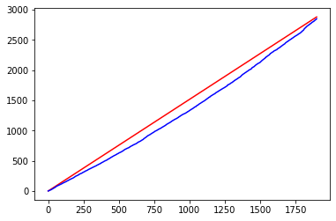
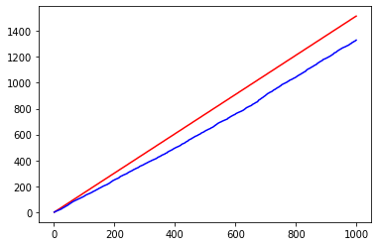
Performance: Estimating number needed to screen
To Find 983 screening-successes, out of 3980 valid individuals. We need to screen 1304 individuals using the model, instead of 1490 using the baseline approach (~12.5% less). A total of 1989 individuals can be found using the baseline approach

Slide 12
Clinical Trial #2 – NCT02993406
Evaluation of Major Cardiovascular Events in Patients With, or at High Risk for, Cardiovascular Disease Who Are Statin Intolerant Treated With Bempedoic Acid (ETC-1002) or Placebo (CLEAR Outcomes)
14014 participants , 1360 locations.
Primary outcome: Time from randomization to first occurrence of one of the following adjudicated composite endpoints: CV death, nonfatal myocardial infarction (MI), nonfatal stroke, or coronary revascularization
Active. To be completed in 2022

Slide 13
NCT02993406 : Eligibility
Inclusion criteria:
Age between 18 and 85 years
History of, or at high risk for, cardiovascular disease (CVD) including coronary artery disease, symptomatic peripheral arterial disease, cerebrovascular atherosclerotic disease, or at high risk for a cardiovascular event
Patient reported history of statin intolerance (inability to tolerate 2 or more statins, one at a low dose)
Men and nonpregnant, nonlactating women
Fasting blood LDL-cholesterol ≥ 100 (2.6 mmol/L) at screening
Exclusion Criteria:
Fasting blood triglycerides greater than 500 mg/dL (5.6 mmol/L) at screening
Recent (within 90 days of screening) history of major cardiovascular events, transient ischemic attack (TIA), or unstable or symptomatic cardiac arrhythmia
History of severe heart failure
Uncontrolled hypertension or uncontrolled diabetes

Slide 14
NCT02993406 : Eligibility
Inclusion criteria:
Age between 18 and 85 years
History of, or at high risk for, cardiovascular disease (CVD) including coronary artery disease, symptomatic peripheral arterial disease, cerebrovascular atherosclerotic disease, or at high risk for a cardiovascular event
Patient reported history of statin intolerance (inability to tolerate 2 or more statins, one at a low dose)
Men and nonpregnant, nonlactating women
Fasting blood LDL-cholesterol ≥ 100 (2.6 mmol/L) at screening
Exclusion Criteria:
Fasting blood triglycerides greater than 500 mg/dL (5.6 mmol/L) at screening
Recent (within 90 days of screening) history of major cardiovascular events, transient ischemic attack (TIA), or unstable or symptomatic cardiac arrhythmia
History of severe heart failure
Uncontrolled hypertension or uncontrolled diabetes

Slide 15
NCT02993406 : Eligibility
Inclusion criteria:
Age between 18 and 85 years
History of, or at high risk for, cardiovascular disease (CVD) including coronary artery disease, symptomatic peripheral arterial disease, cerebrovascular atherosclerotic disease, or at high risk for a cardiovascular event
Patient reported history of statin intolerance (inability to tolerate 2 or more statins, one at a low dose)
Men and nonpregnant, nonlactating women
Fasting blood LDL-cholesterol ≥ 100 (2.6 mmol/L) at screening
Exclusion Criteria:
Fasting blood triglycerides greater than 500 mg/dL (5.6 mmol/L) at screening
Recent (within 90 days of screening) history of major cardiovascular events, transient ischemic attack (TIA), or unstable or symptomatic cardiac arrhythmia
History of severe heart failure
Uncontrolled hypertension or uncontrolled diabetes

Slide 16
NCT02993406 : Eligibility
Inclusion criteria:
Age between 18 and 85 years
History of, or at high risk for, cardiovascular disease (CVD) including coronary artery disease, symptomatic peripheral arterial disease, cerebrovascular atherosclerotic disease, or at high risk for a cardiovascular event
Patient reported history of statin intolerance (inability to tolerate 2 or more statins, one at a low dose)
Men and nonpregnant, nonlactating women
Fasting blood LDL-cholesterol ≥ 100 (2.6 mmol/L) at screening
Exclusion Criteria:
Fasting blood triglycerides greater than 500 mg/dL (5.6 mmol/L) at screening
Recent (within 90 days of screening) history of major cardiovascular events, transient ischemic attack (TIA), or unstable or symptomatic cardiac arrhythmia
History of severe heart failure
Uncontrolled hypertension or uncontrolled diabetes

Slide 17
NCT02993406 : Eligibility
Inclusion criteria:
Age between 18 and 85 years
History of, or at high risk for, cardiovascular disease (CVD) including coronary artery disease, symptomatic peripheral arterial disease, cerebrovascular atherosclerotic disease, or at high risk for a cardiovascular event
Patient reported history of statin intolerance (inability to tolerate 2 or more statins, one at a low dose)
Men and nonpregnant, nonlactating women
Fasting blood LDL-cholesterol ≥ 100 (2.6 mmol/L) at screening
Exclusion Criteria:
Fasting blood triglycerides greater than 500 mg/dL (5.6 mmol/L) at screening
Recent (within 90 days of screening) history of major cardiovascular events, transient ischemic attack (TIA), or unstable or symptomatic cardiac arrhythmia
History of severe heart failure
Uncontrolled hypertension or uncontrolled diabetes

Slide 18
Performance: NN to Screen and to Enroll
NN2S – measuring the prediction of the screening success (LDL and Triglycerides).
Similar approach as in previous trial
NN2E – number of screening-valid individuals per case
Case - cardiovascular event withing ~4 years)
Compare baseline (Framingham score and ‘history of’) to a full model of predicting a case

Slide 19
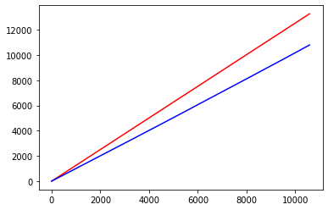
Performance: Estimating number needed to screen
To Find 14014 screening-successes, out of 38810 valid individuals. We need to screen 14534 individuals using the model. This cannot achieved with the baseline approach. For 10588 successes, the model requires 10807 individuals, compared to 13281 with the baseline approach (18.5% less)

Slide 20
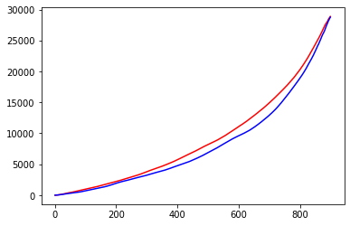
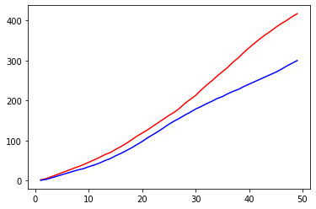
Performance: Estimating number needed to enroll (Low numbers – running bootstrap)
To Find 50 events among screening-successes, out of ~1000. We need to enroll 307 individuals using the model, instead of 425 using only the history (~28% less)

Slide 21
Clinical Trial #3 – NCT03036150
A 4 years Study on Dapagliflozin vs Placebo in CKD patients. Measure the effect on renal, cardiovascular and mortality
4304 participants , 392 locations
Primary outcome: Time to the first occurrence of any of the components of the composite: ≥50% sustained decline in eGFR or reaching ESRD or CV death or renal death
Completed

Slide 22
NCT03036150: Eligibility
Inclusion Criteria:
Provision of signed informed consent prior to any study specific procedures
Female or male aged ≥18 years at the time of consent
eGFR ≥25 and ≤75 mL/min/1.73m2 (CKD-EPI Formula) at visit 1
Evidence of increased albuminuria 3 months or more before visit 1
UACR ≥200 and ≤5000 mg/g at visit 1
Stable, and for the patient maximum tolerated labelled daily dose, treatment with ACE-I or ARB for at least 4 weeks before visit 1, if not medically contraindicated
Exclusion Criteria:
Autosomal dominant or autosomal recessive polycystic kidney disease, lupus nephritis or ANCA-associated vasculitis
Receiving cytotoxic therapy, immunosuppressive therapy or other immunotherapy for primary or secondary renal disease within 6 months prior to enrolment
History of organ transplantation
Receiving therapy with an SGLT2 inhibitor within 8 weeks prior to enrolment or previous intolerance of an SGLT2 inhibitor
Type 1 diabetes mellitus
New York Heart Association (NYHA) class IV Congestive Heart Failure at the time of enrolment
MI, unstable angina, stroke or transient ischemic attack within 12 weeks prior to enrolment

Slide 23
NCT03036150: Eligibility
Inclusion Criteria:
Provision of signed informed consent prior to any study specific procedures
Female or male aged ≥18 years at the time of consent
eGFR ≥25 and ≤75 mL/min/1.73m2 (CKD-EPI Formula) at visit 1
Evidence of increased albuminuria 3 months or more before visit 1. (UACR > 30)
UACR ≥200 and ≤5000 mg/g at visit 1
Stable, and for the patient maximum tolerated labelled daily dose, treatment with ACE-I or ARB for at least 4 weeks before visit 1, if not medically contraindicated
Exclusion Criteria:
Autosomal dominant or autosomal recessive polycystic kidney disease, lupus nephritis or ANCA-associated vasculitis
Receiving cytotoxic therapy, immunosuppressive therapy or other immunotherapy for primary or secondary renal disease within 6 months prior to enrolment
History of organ transplantation
Receiving therapy with an SGLT2 inhibitor within 8 weeks prior to enrolment or previous intolerance of an SGLT2 inhibitor
Type 1 diabetes mellitus
New York Heart Association (NYHA) class IV Congestive Heart Failure at the time of enrolment
MI, unstable angina, stroke or transient ischemic attack within 12 weeks prior to enrolment

Slide 24
NCT03036150: Eligibility
Inclusion Criteria:
Provision of signed informed consent prior to any study specific procedures
Female or male aged ≥18 years at the time of consent
eGFR ≥25 and ≤75 mL/min/1.73m2 (CKD-EPI Formula) at visit 1
Evidence of increased albuminuria 3 months or more before visit 1
UACR ≥200 and ≤5000 mg/g at visit 1
Stable, and for the patient maximum tolerated labelled daily dose, treatment with ACE-I or ARB for at least 4 weeks before visit 1, if not medically contraindicated
Exclusion Criteria:
Autosomal dominant or autosomal recessive polycystic kidney disease, lupus nephritis or ANCA-associated vasculitis
Receiving cytotoxic therapy, immunosuppressive therapy or other immunotherapy for primary or secondary renal disease within 6 months prior to enrolment
History of organ transplantation
Receiving therapy with an SGLT2 inhibitor within 8 weeks prior to enrolment or previous intolerance of an SGLT2 inhibitor
Type 1 diabetes mellitus
New York Heart Association (NYHA) class IV Congestive Heart Failure at the time of enrolment
MI, unstable angina, stroke or transient ischemic attack within 12 weeks prior to enrolment

Slide 25
Simulating Recruitment
> 3 months
1 month
01/01/2017
31/12/2017
> 3 months
1 month
Select random date for patient from all optional dates with eGFR and at least 3 months UACR and UACR within 1 month prior or after eGFR test
eGFR test – “visit 1”
UACR test

Slide 26
Modeling Screening Success/Fail
Order candidate according to models …
Basic Model – “Baseline multiply”
Predict value of lab test based on latest value in 6 years
Recalibrate to predict inclusion/exclusion criterion
Multiply different calibrated model
Full Model – “full multiply”
Use full MES model to predict lab test
Combined model – “combined optimized”
Explicitly learn combined eligibility criteria
Combined simple model – “baseline combined”
Explicitly learn combined eligibility criteria with simple model of age, gender and last lab test

Slide 27
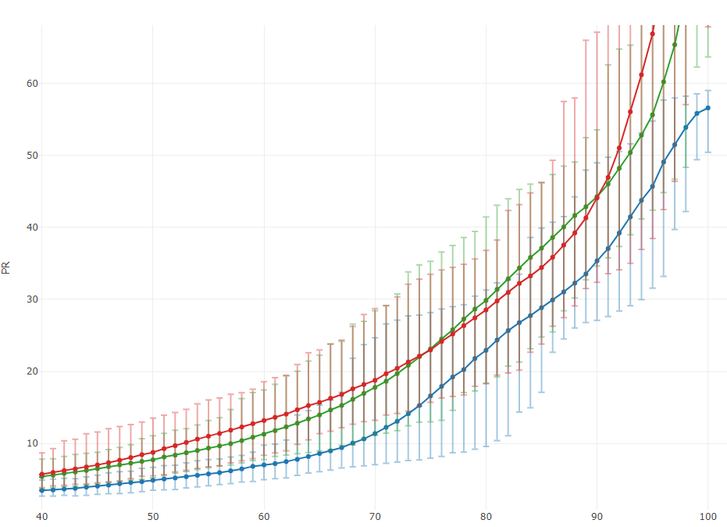
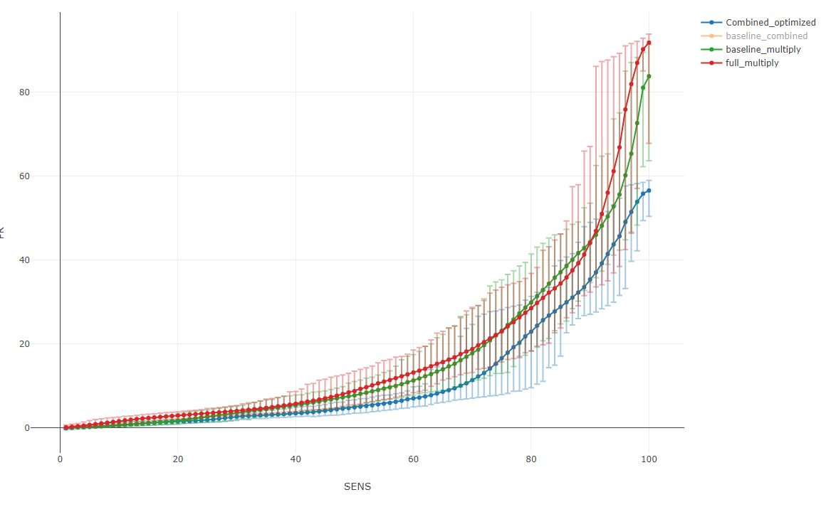
Performance: Estimating number needed to screen
Many many inclusion/exclusion criteria with time conditions – small cohort of about 2500 candidates. Big confidence intervals. 83 cases in total
Lower is better. The best model is the “combined optimized”, when trying to reach higher sensitivity levels > 20%
Using a simpler baseline combined model reached a similar result

Slide 28
Performance: Estimating number needed to screen
PR@SENS_X | baseline_multiply | full_multiply | baseline_Combined | Combined_optimized | Improve
20 | 1.7[0.9 - 3.4] | 2.9[2.1 - 3.8] | 1.2[0.7 - 2.0] | 1.5[1.0 - 1.9] | 11.8%
25 | 2.7[1.4 - 4.3] | 3.5[2.5 - 4.6] | 1.8[1.1 - 2.5] | 1.9[1.4 - 2.9] | 29.6%
30 | 3.6[2.1 - 5.2] | 4.0[3.1 - 5.4] | 2.3[1.6 - 3.3] | 2.7[1.8 - 3.4] | 25.0%
35 | 4.5[3.0 - 6.6] | 4.8[3.5 - 6.9] | 2.9[2.0 - 4.1] | 3.1[2.3 - 4.2] | 31.1%
40 | 5.4[3.7 - 7.8] | 5.7[3.9 - 8.7] | 3.6[2.4 - 5.0] | 3.5[2.7 - 4.9] | 35.2%
45 | 6.5[4.4 - 8.8] | 7.0[4.5 - 11.6] | 4.4[2.8 - 5.9] | 4.1[2.9 - 5.6] | 36.9%
50 | 7.7[5.3 - 11.1] | 8.8[5.5 - 13.5] | 5.2[3.5 - 6.9] | 4.9[3.5 - 6.7] | 36.4%
55 | 9.4[6.6 - 13.2] | 11.0[6.8 - 16.0] | 6.1[4.4 - 8.1] | 5.8[4.2 - 7.8] | 38.3%
60 | 11.3[7.8 - 17.4] | 13.2[8.4 - 18.6] | 7.2[5.2 - 10.3] | 7.0[5.0 - 9.8] | 38.1%
65 | 14.0[9.0 - 22.3] | 15.7[11.4 - 23.0] | 8.9[5.8 - 13.4] | 8.6[6.1 - 15.3] | 38.6%
70 | 17.8[11.1 - 28.4] | 18.8[13.2 - 28.7] | 11.5[6.9 - 19.0] | 11.4[7.1 - 24.7] | 36.0%
75 | 23.1[13.0 - 35.3] | 23.0[15.7 - 33.5] | 15.1[8.5 - 21.9] | 16.6[8.0 - 28.2] | 28.1%
80 | 29.9[18.4 - 41.4] | 28.5[18.3 - 36.8] | 20.1[11.4 - 37.5] | 22.9[9.6 - 31.3] | 23.4%
85 | 37.1[24.8 - 46.2] | 34.4[23.8 - 46.2] | 28.1[14.3 - 46.8] | 28.9[17.1 - 39.9] | 22.1%
90 | 44.3[34.6 - 53.5] | 44.1[32.4 - 67.1] | 39.8[21.3 - 52.2] | 35.4[27.1 - 49.0] | 20.1%
95 | 55.6[42.4 - 75.0] | 66.8[38.5 - 89.2] | 54.3[38.8 - 77.7] | 45.7[31.6 - 54.7] | 17.8%
100 | 83.8[63.7 - 91.3] | 91.8[67.8 - 93.8] | 83.7[56.3 - 89.7] | 56.6[50.4 - 59.0] | 32.5%

Slide 29
Disclaimers
Quick & dirty – might still have bugs
No Confidence intervals shown
Using a large population. In real life we might get to lower scores with lower benefit
Did not compare to Framingham Score.

